Slide 1
GH-100: GitHub Fundamentals - Administration basics and product features Part 2
GitHub Fundamentals - Administration basics and product features
- Part 2
Notes:
https://learn.microsoft.com/en-us/training/paths/github-admin-2/github-admin-2

Slide 2
Module 5: Manage sensitive data and security policies within GitHub
Module 5: Manage sensitive data and security policies within GitHub
Notes:
Title: Module 5: Manage sensitive data and security policies within GitHub
Learning Objectives:
By the end of this unit, you'll be able to:
Create documentation that details security guidelines and useful information for collaborators.
Set permissions and other rules.
Automate processes that prevent security breaches.
Respond to security breaches.
Module Units
Introduction - 1 min
Setting security policies - 15 min
Create and manage repository rulesets - 25 min
Reporting and logging - 25 min
Exercise - 20 min
Module assessment - 5 min
Summary - 5 min

Slide 3
Introduction
In this unit, you will learn how to secure your organization’s repositories using GitHub’s built‑in tools—branch protection, dependency alerts, and code and secret scanning—and enforce role‑based access to prevent unauthorized changes. You’ll also discover best practices for responding to security breaches, tailoring SECURITY.md policies, and maintaining project integrity without hindering collaboration.
By the end of this unit, you'll be able to:
Create documentation that details security guidelines and useful information for collaborators.
Set permissions and other rules & Manage repository rulesets.
Automate processes that prevent security risks & Respond to sensitive data exposure.
Export audit log records and git events.
Notes:
Security is a cornerstone of any successful software project, and GitHub’s built‑in features give you the tools to protect both your code and your secrets. In a collaborative organization, it’s not enough to write secure code—you also need guardrails that enforce the right access controls, scan for vulnerabilities, and respond swiftly if something goes wrong.
Imagine you’ve just launched a new repository for your team’s latest initiative. Without proper safeguards, it’s easy for credentials to slip into commits or for contributors to overstep their roles, creating technical debt and exposing sensitive data. Worse still, you might not know who to turn to for remediation when issues arise.
As an administrator, you can eliminate these risks by leveraging GitHub’s security toolkit: everything from branch protection and dependency alerts to code and secret scanning. In this module, you’ll learn to configure these features, draft clear SECURITY.md guidelines, and automate policies that keep your project both safe and friction‑free. You’ll also practice incident response—removing exposed data and auditing events—so your organization can maintain its reputation and avoid costly fixes down the road.

Slide 4
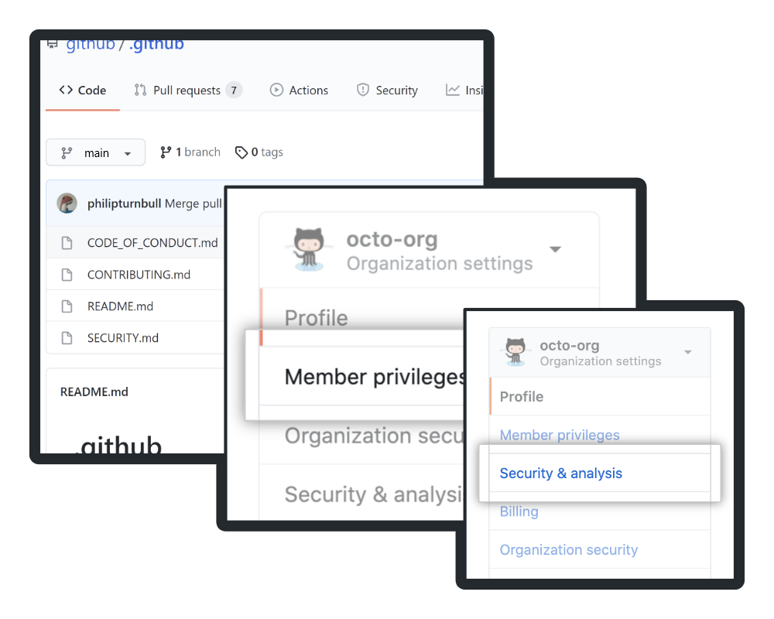
Setting security policies
In this unit, you’ll learn how to set up preventive measures, document vulnerabilities, leverage GitHub’s security tools (including enterprise-grade and compliance features), scrub sensitive data when needed, manage policies, and audit activity.
Imagine you’re an admin onboarding new collaborators: you want them in the right repos, reporting issues clearly, and following consistent standards. Let’s set your security policies.
Notes:
In this unit, we’re going to formalize the guardrails that keep your projects secure and consistent. You’ll learn how to:
Document your security posture with clear policies and a SECURITY.md so collaborators know how to report and handle vulnerabilities.
Apply preventive controls like branch protection, dependency alerts, and secret scanning to catch issues before they reach production.
Leverage advanced features—from enterprise compliance settings to automated remediation via Dependabot and security advisories.
Clean up sensitive data when it inevitably slips in, and
Audit activity using GitHub’s logs and rulesets to verify that policies are being followed.
Imagine you’re onboarding a group of new contributors: your goal is to make sure they land in the right repositories, report issues in the right format, and follow unified standards—without bottlenecking their productivity. By the end of this unit, you’ll have configured the policies and workflows that automate security best practices, so every team member can collaborate safely and efficiently.

Slide 5



Why security policies matter
Security policies maintain your GitHub ecosystem’s integrity by:
Guiding workflows:
Reporting clarity:
Access control:
Secure, standardized processes
Clear steps for vulnerability disclosure
Least-privilege permissions to limit risk
Apply policies at the repo, org, or enterprise level—enterprise-wide rules enforce uniformity, while org-level settings let you tailor per project.
Notes:
Security policies are the invisible scaffolding that keeps your GitHub ecosystem both safe and predictable.
Guiding workflows: By defining standardized processes—like required code reviews, status checks, and automated scans—you ensure every contributor follows the same secure steps. This consistency reduces mistakes and makes compliance second nature.
Reporting clarity: A clear vulnerability-disclosure pathway—documented in your SECURITY.md—tells researchers exactly how, where, and to whom they should report issues. That transparency speeds up remediation and builds trust with your community.
Access control: Enforcing least-privilege permissions means users only see and change what they absolutely need. By limiting who can push to protected branches or access sensitive data, you dramatically shrink your attack surface.
Finally, remember that you can apply these policies at different scopes:
Repository level for project-specific rules,
Organization level to tailor settings per team, or
Enterprise level to enforce uniform policies across every organization under your account.
Choosing the right scope ensures both flexibility and consistency, so you maintain security without sacrificing agility.

Slide 6
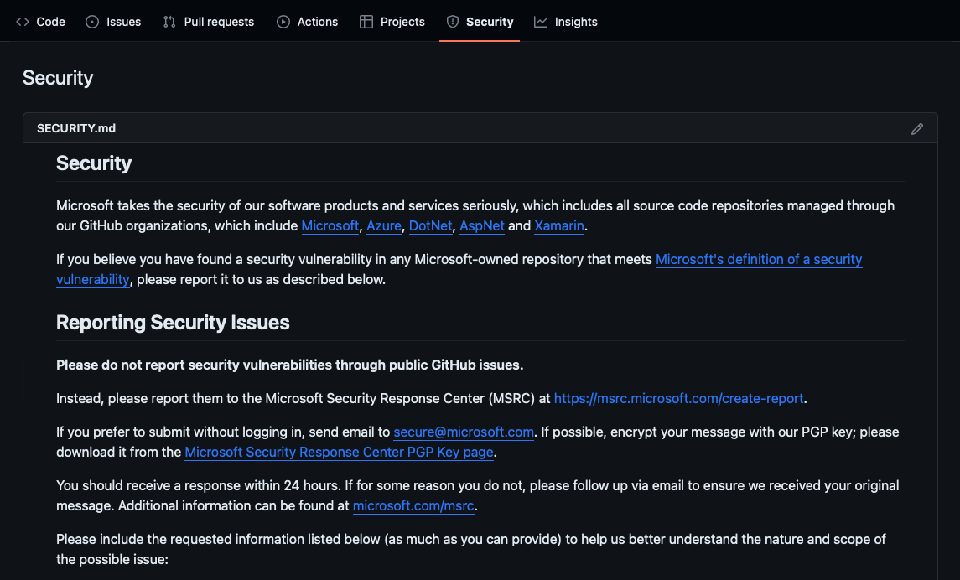
Documenting security
Clear docs are the first defense.
SECURITY.md
The SECURITY.md file tells users which versions you support, how to report issues, and any legal disclaimers or known risks.
Notes:
Clear, accessible documentation is your first line of defense against security risks.
By including a SECURITY.md file in the root of your repository, you set expectations for both your maintainers and your community. This file should outline the versions you support, provide a step‑by‑step guideline for responsibly reporting vulnerabilities—whether via email, issue templates, or a vulnerability disclosure form—and include any legal disclaimers or known risks they need to be aware of.
When someone discovers an issue, they’ll know exactly where to look and how to communicate it, which dramatically speeds up your triage and resolution process.
Make sure you link to SECURITY.md prominently in your README or project homepage, and update it regularly as your project’s support policy and risk profile evolve.

Slide 7
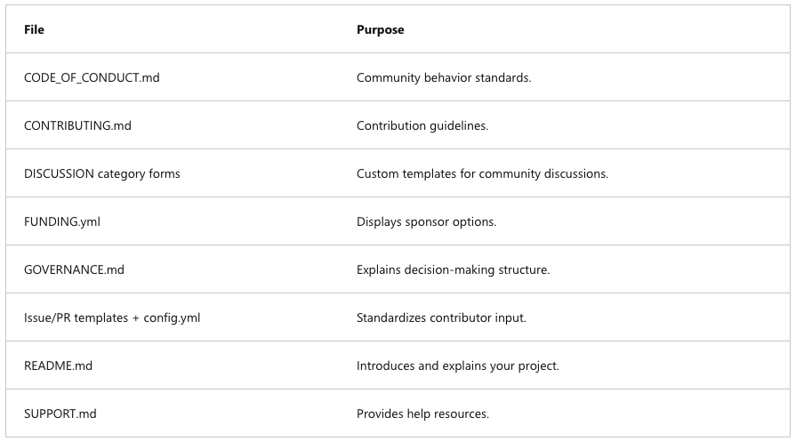
Other community health files
GitHub recognizes key community files that improve project transparency:
Notes:
Beyond security, GitHub promotes a healthy, transparent project culture through a set of well‑recognized community files. Including these not only informs contributors but also sets clear expectations for behavior, decision making, and support channels. Let’s run through the key files you should consider adding:
CODE_OF_CONDUCT.md: Defines acceptable behavior and enforces community standards, helping to foster a respectful, inclusive environment.
CONTRIBUTING.md: Outlines how to contribute—coding conventions, workflow steps, and any prerequisites—so new contributors can get up to speed quickly and consistently.
Issue/PR Templates and config.yml: Standardizes how bugs and feature requests are reported through templates, ensuring you collect all necessary information for efficient triage.
DISCUSSION Category Forms: Customizes your Discussions tab with pre‑formatted topics—like Q&A or Show & Tell—so community conversations start in the right channel and format.
FUNDING.yml: Displays sponsorship options on your repo homepage, making it easy for users to support the project financially.
GOVERNANCE.md: Explains your project’s decision‑making structure—who holds votes, how to propose changes—so contributors understand how to influence the roadmap.
README.md: Serves as your project’s front door with an overview, installation steps, and usage examples—crucial for welcoming and orienting newcomers.
SUPPORT.md: Lists help resources—links to docs, community forums, chat channels—so users know exactly where to go when they need assistance.
By including these files, you establish clarity around process, roles, and resources—laying the foundation for a thriving, sustainable open‑source community.

Slide 8
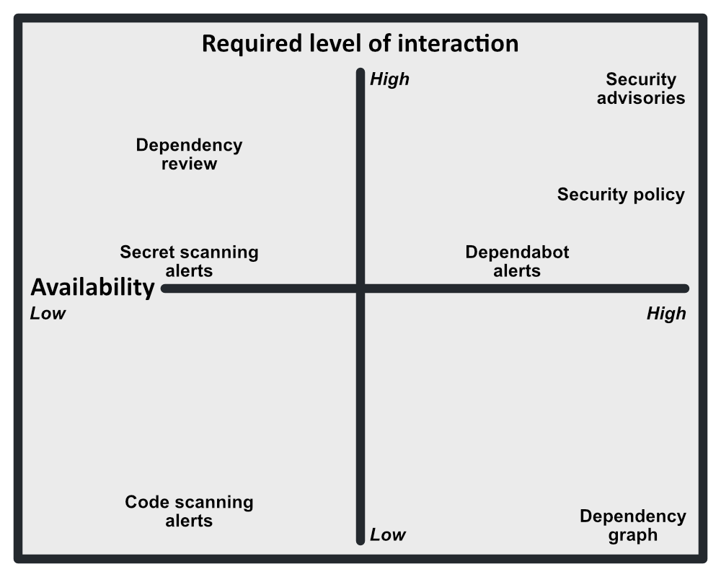
Security settings & enforcement
Choose trust vs. control based on team size: small teams might use broad permissions; large teams need stricter policies.
Configuration levels
Org-level: Settings > Member privileges
Enterprise-level: Your enterprises > Policies > Repository policies
Enterprise rules override org rules; org owners can’t change locked settings.
Note: Features and required interactions vary by repo type and license.
Available security tools
All repos: Access controls, SECURITY.md, Dependabot alerts/updates, advisories
With Advanced Security: Code scanning, secret scanning, dependency review
Notes:
Finding the right balance between trust and control starts with understanding your team’s size and workflow. For smaller teams, you might lean into broader default permissions—empowering everyone to move quickly without constant gatekeeping. As your organization grows, however, stricter policies become essential to prevent mistakes and reduce risk. Always align your controls with the scale and sensitivity of your projects.”
“Configuration happens at two levels:
Organization level: Under Settings → Member privileges, you define the base permissions every member inherits by default.
Enterprise level: In Your enterprises → Policies → Repository policies, you set enterprise‑wide guardrails that cascade down to organizations. Remember, enterprise rules take precedence—once locked, org owners can’t override them.
Note: The exact features and required interactions depend on your repository type (public, private, or internal) and your GitHub license (Free, Team, or Enterprise).
In the diagram, you see a four‑quadrant view: the horizontal axis represents how widely available each tool is, while the vertical axis shows how much user interaction it demands. Low‑interaction controls like SECURITY.md are broadly available, whereas more advanced features—like code scanning with Advanced Security—sit in the quadrant requiring higher interaction but offering deeper protection.
Available security tools:
All repositories benefit from access controls, a SECURITY.md policy file, Dependabot alerts and auto‑updates, and GitHub Security Advisories.
With Advanced Security enabled, you unlock CodeQL code scanning, secret scanning, and dependency review—tools that provide proactive, automated detection of vulnerabilities right in your workflow.

Slide 9


Enhancing Enterprise Security with GitHub
GitHub offers a comprehensive suite of security features and compliance tools designed to enhance an enterprise's security posture and ensure adherence to industry standards.
Security Features:
GitHub Advanced Security (GHAS):
Provides advanced capabilities such as code scanning, secret scanning, and dependency reviews to identify vulnerabilities and protect code integrity.
Security Configurations:
Allows enterprises to enforce consistent security settings across all repositories, ensuring uniform protection and compliance.
Compliance Support:
Access to Compliance Reports:
Enterprises can access GitHub's compliance reports, including SOC 1 Type 2, SOC 2 Type 2, and ISO/IEC 27001:2013 certifications, to meet regulatory requirements and demonstrate adherence to industry standards.
Notes:
At the enterprise level, GitHub equips you with advanced tools and controls to elevate your security posture and simplify compliance.
First, GitHub Advanced Security (GHAS) brings powerful automated safeguards directly into your workflows:
Code scanning uses CodeQL to detect vulnerabilities and coding errors before they reach production.
Secret scanning continuously hunts for exposed credentials in your commits and alerts you in real time.
Dependency review surfaces vulnerable dependencies in pull requests, so you can address risks before merging.
Next, Security Configurations let you enforce consistency across all repositories—whether public, private, or internal. By defining enterprise‑wide rulesets, you lock down branch protections, status checks, and required review policies uniformly, ensuring no project slips through the cracks.
Finally, on the compliance front, GitHub provides audit‑ready reports and aligns with major standards—SOC 1 Type 2, SOC 2 Type 2, and ISO 27001:2013—so you can demonstrate your security controls to auditors and regulators with confidence. Together, these enterprise features form a comprehensive, scalable framework that secures your entire organization without slowing down your development teams.

Slide 10
Scrubbing Sensitive Data from a Git Repository
Using git filter-branch (Legacy Method)
Using BFG Repo-Cleaner (Recommended)
Identify the file containing sensitive data:
Use filter-branch to remove the file from history:
Force push the rewritten history:
Remove cached objects:
BFG is a simpler and faster alternative to git filter-branch.
Install BFG
To remove all occurrences of a specific string (e.g., an API key)
Clean up and force push changes:
git log --follow -- path/to/sensitive\_file
java -jar bfg.jar --delete-files path/to/sensitive_file.git
git filter-branch --force --index-filter `git rm --cached --ignore-unmatch path/to/sensitive_file` --prune-empty --tag-name-filter cat -- --all
java -jar bfg.jar --replace-text passwords.txt
git push origin --force --all
git push origin --force --tags
git reflog expire --expire=now --all
git gc --prune=now --aggressive
git push origin --force --all
rm -rf .git/refs/original && git reflog expire --expire=now --all && git gc --prune=now
Notes:
When a secret—like an API key or password—slips into your Git history, you must treat it as compromised and remove it from every commit, not just the latest. There are two main approaches:
Legacy method: You can use git filter-branch to rewrite history by removing the file across all branches and tags. The command shown removes path/to/sensitive_file from every commit, pruning empty commits and updating tags. However, this approach can be slow and error‑prone on large repos.
Recommended method: The BFG Repo‑Cleaner offers a faster, more user‑friendly alternative. You point it at your repo to delete specific files, or supply a passwords.txt with strings to replace. BFG rewrites your entire history in minutes and handles large repositories far more efficiently than filter-branch.
Once you’ve run either tool, you need to:
Expire your reflog and garbage‑collect unreferenced objects (git reflog expire --expire=now --all and git gc --prune=now --aggressive).
Force‑push the rewritten history back to the remote (git push origin --force --all).
Important: After scrubbing, immediately rotate any exposed credentials, inform your team, and have all collaborators reclone the cleaned repository. If you run into issues or need assistance, GitHub Support can help ensure the sensitive data is fully purged from GitHub’s backend.

Slide 11
Scrubbing Sensitive Data from GitHub (Contacting Support)
If sensitive data has been exposed in a public GitHub repository, simply deleting it from history may not be enough. Cached versions may still exist, and web crawlers may have indexed the information.
Step 1
Step 2
Step 3
Delete the Repository (if necessary):
Rewriting History & Force Pushing:
Request Permanent Data Removal:
If the repository contains critical leaks, consider deleting it immediately.
Follow the steps above to scrub data and force-push changes.
Contact GitHub Support via GitHub’s Contact Page
Provide:
Repository name
Specific files or commits containing sensitive data
Confirmation that history has been rewritten
Request GitHub to flush caches and remove indexed data.
Notes:
Even if you scrub your Git history, there’s still a chance that the sensitive data is cached somewhere on GitHub’s servers—or has been picked up by search engines.
In these cases, it’s time to contact GitHub Support.
You’ll need to:
Delete the repo (if the leak is critical).
Rewrite history and force-push the changes.
Provide GitHub with the repo name, specific commits, and confirmation that you’ve cleaned the history.
Then, request GitHub to flush their caches and remove indexed content. The sooner you act, the more effective this process will be.

Slide 12

Preventative Measures
 | Use .gitignore to prevent committing sensitive files.
 | Store secrets securely using environment variables or secret management tools (e.g., GitHub Secrets, AWS Secrets Manager).
 | Regularly audit repositories for sensitive data leaks using tools like GitGuardian or truffleHog.
Notes:
The best way to deal with sensitive data leaks is to not commit them in the first place.
Use a .gitignore file to keep secrets out of the repo entirely.
Store secrets in environment variables or tools like GitHub Secrets or AWS Secrets Manager.
Run tools like GitGuardian or truffleHog to audit your repos regularly for anything sensitive that may have slipped through.
These practices help you stay ahead of issues and keep your repositories secure by default.

Slide 13



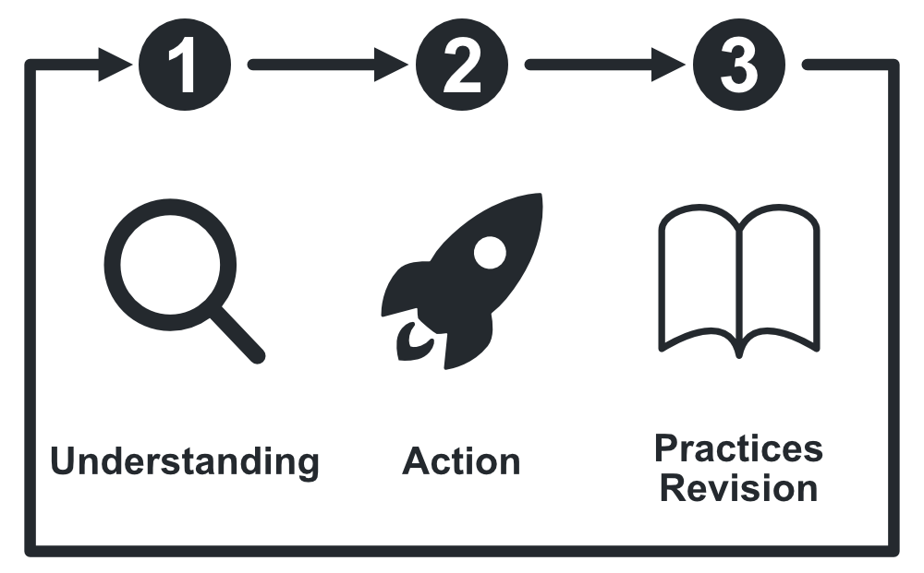
Publishing security advisories
When vulnerabilities arise, use GitHub security advisories to:
Privately collaborate on fixes
Clearly communicate details
Document mitigation steps
A good advisory lists the affected versions, severity, patch status, and CVE references. Use GitHub’s built-in workflow to manage and publish advisories efficiently.
Notes:
When your team uncovers a vulnerability, GitHub Security Advisories provide a private workspace to collaborate on a fix before any public disclosure.
First, you can privately collaborate with maintainers to draft patches and discuss technical details without tipping off potential attackers.
Then, when you’re ready, you use the same advisory to clearly communicate the issue to your users—laying out what’s affected, the severity level, and any workarounds.
Finally, you document mitigation steps and link to CVE entries so downstream projects can automate notifications and updates.
A robust advisory should always include:
Affected versions so users know if they’re at risk
Severity classification to help prioritize responses
Patch status indicating whether a fix is available
CVE references for consistency with industry databases
By leveraging GitHub’s built‑in advisory workflow—from draft through publication—you streamline the entire process, ensuring you handle vulnerabilities both quickly and transparently.

Slide 14


Enabling secure software development and ensuring compliance
Each policy is designed to balance security and usability, offering options that range from minimal restrictions to highly controlled environments. The table below provides an overview of various security policies categorized by their level of control.
Low Control
Moderate Control
High Control
(Guidance & Best Practices)
Security advisories & code scanning
Dependabot alerts
Repository branch protection rules (optional reviews)
Teams that need flexibility while following best security practices.
(Enforced Rules)
Required branch protection rules Commit signing enforcement
Organization-wide security policies
Webhooks for monitoring
Teams that need some governance but allow developer autonomy.
(Strict Compliance & Governance)
Enforce SAML SSO & 2FA
Restrict repository visibility & forking
Mandatory pull request approvals
Prevent force pushes
Require security checks in CI/CD
Organizations with strict compliance requirements (e.g., SOC 2, ISO 27001).
Notes:
In real‑world environments, the right balance between security and productivity varies by team and regulatory requirements. We can think of security policies along a spectrum—from Low Control, where we provide guidance and best practices, to High Control, where we enforce strict compliance measures.
Low Control: Here, we equip teams with advisory tools—security advisories, CodeQL code scanning, Dependabot alerts, and optional branch protection reviews. This approach works well for agile teams that value flexibility but still want to follow solid security practices without mandatory gates.
Moderate Control: At this level, we turn on enforced rules: required branch protections, commit signing, organization‑wide security policies, and monitoring webhooks. Developers retain autonomy within their feature branches, but we ensure that every merge meets agreed‑upon standards. This model suits teams who need governance without micromanaging day‑to‑day development.
High Control: For industries with strict compliance mandates—like finance, healthcare, or government—we dial up to the most restrictive settings: mandatory SAML SSO and two‑factor authentication, disabled forking or limited visibility, required pull‑request approvals, no force‑pushes, and comprehensive CI/CD security checks. This environment minimizes risk and provides the audit trails necessary for certifications like SOC 2 or ISO 27001.
By categorizing policies this way, you can tailor your organization’s security posture to match both your risk tolerance and your team’s working style—scaling from light‑touch guidance all the way to enterprise‑grade enforcement.

Slide 15

Key Security & Compliance Features in GitHub Enterprise
Secure Code Development
Enforcing Compliance Policies
Controlling Access & Authentication
Code Scanning (GitHub Advanced Security) – Automatically detects vulnerabilities in your code.
Secret Scanning – Prevents hardcoded secrets from being exposed.
Dependency Review & Dependabot – Detects vulnerabilities in third-party dependencies.
Branch Protection Rules – Require PR approvals, restrict direct commits, and enforce commit signing.
Security Rulesets – Enforce security policies across repositories.
Audit Logs & API Monitoring – Track all activity within your GitHub organization.
Enforce SAML SSO & 2FA – Ensure strong authentication for all users.
Restrict Repository Visibility – Control who can view, fork, or clone repositories.
Fine-Grained Access Control – Assign roles and permissions per team or project
Notes:
Now let’s break down what tools GitHub gives you to enforce those policies.
Secure Code Development
Code scanning finds vulnerabilities before code is merged.
Secret scanning helps prevent exposed credentials.
Dependency review and Dependabot keep your third-party libraries secure and up to date.
Enforcing Compliance Policies
Use branch protection rules to require reviews and prevent risky merges.
Security rulesets let you apply policies across multiple repositories.
Audit logs and API monitoring give visibility into who did what and when.
Controlling Access & Authentication
Enforce SAML SSO and 2FA to lock down user access.
Control repository visibility so only the right people see the right code.
Apply fine-grained permissions by project or team to limit risk.
All of this gives you a toolkit to secure code and ensure compliance—without disrupting productivity.

Slide 16

When to Use Different Security & Compliance Policies
 | For Startups & Agile Teams → Use moderate control with branch protection, Dependabot, and secret scanning. For Enterprises & Regulated Industries → Enforce SAML SSO, audit logging, security rulesets, and strict repository controls. For Open Source Projects → Focus on branch protections, code scanning, and dependency updates while maintaining developer flexibility.
Notes:
So when do you apply these different policy levels?
If you’re a startup or smaller dev team, start with moderate control: secret scanning, Dependabot, and branch protection go a long way.
For enterprises or regulated industries, go big: enforce SAML, require audits, and apply strict rules across every repo.
If you're managing an open-source project, you'll still want solid protections—like branch rules, code scanning, and dependency updates—but with enough flexibility to allow collaboration.
Matching the policy level to your environment keeps things secure without creating unnecessary friction.

Slide 17



Defining Organization and Enterprise policies
Organization policies are a set of rules and configurations that define how users, teams, and repositories within an enterprise or organization must operate to ensure security, compliance, and efficiency. These policies enforce governance, access control, and development workflows, ensuring consistency across all projects. Check out these Key Aspects of Organization Policies:
Security & Access Control
Compliance & Governance
Enforcing SAML SSO and 2FA for authentication.
Managing repository visibility (private vs. public).
Defining role-based access controls (RBAC) for users and teams.
Enabling audit logging to track changes and user actions.
Implementing branch protection rules to enforce code review policies.
Requiring signed commits to verify the identity of contributors.
Development Workflow & Automation
Code & Dependency Security
Enforcing pull request approvals before merging.
Using security rulesets to ensure best practices for secure coding.
Managing CI/CD pipelines using GitHub Actions policies.
Enforcing code scanning and secret scanning.
Using Dependabot for dependency management.
Restricting the use of third-party GitHub Actions.
Notes:
Let’s begin with the security backbone of organizational policies—access control.
These policies enforce SAML SSO and 2FA, ensuring users are properly authenticated. You can also manage repository visibility to keep sensitive code private and use role-based access control (RBAC) to ensure users and teams have only the access they need.
The goal here is to protect your environment by keeping control tightly aligned with responsibilities—no more, no less.
Next up is compliance—something that becomes more important as your team scales or works in regulated industries.
Policies like audit logging help you track who did what and when. You can enforce branch protection rules to make sure every change is reviewed, and require signed commits so you can verify the identity of contributors.
These rules don’t just help with audits—they keep your development process transparent and trustworthy.
Policies also help you standardize and streamline how teams work.
For example, you can require pull request approvals before merging changes and use security rulesets to automatically enforce coding best practices. You can even manage CI/CD behavior using GitHub Actions policies—defining what’s allowed, what needs approval, and what can run automatically.
This ensures that no matter which team is shipping code, the process stays consistent and secure.
Let’s talk about protecting your codebase and its dependencies.
Organization policies can enforce code scanning and secret scanning, which help catch vulnerabilities and sensitive information before it becomes a problem. Tools like Dependabot help you stay on top of third-party dependencies.
And to reduce risk, you can restrict the use of third-party GitHub Actions—only allowing trusted tools into your automation workflows.
These policies work behind the scenes to improve security without slowing developers down.

Slide 18
Create and manage repository rulesets
In this unit, you’ll learn how to create and manage rulesets, and understand the advantages they offer over traditional protection rules.
As a GitHub administrator, you need granular control over who can push, delete, or rename branches and tags. Repository rulesets let you bundle multiple rules under a single name, apply them to selected branches or tags, and toggle them on or off without deleting them. They complement existing branch- and tag-protection rules, giving you a unified, layered approach to repository security.
Notes:
In this unit, we’re moving beyond individual branch protections to a more scalable model: repository rulesets. You’ll learn how to bundle multiple security rules—status checks, required reviews, push restrictions, and more—into a single, named ruleset that you can apply to any combination of branches or tags. This approach simplifies administration by letting you toggle entire sets of rules on or off, clone them across repos, or update them in one place without touching each protection individually.
As a GitHub administrator, you often need fine‑grained control over who can push, delete, or rename branches and tags. Rulesets give you that precision, complementing existing branch‑ and tag‑protection settings with a unified, layered approach to repository security. By the end of this unit, you’ll be comfortable creating, configuring, and managing rulesets—so you can enforce the right safeguards consistently across all your critical code paths.

Slide 19



What are repository Rulesets?
A ruleset is a named collection of rules that apply to one or more branches or tags in your repository.
Target selection:
Rule definitions:
Bypass permissions:
Choose specific branches (e.g., feature/*) or tags (e.g., v*.*).
Require status checks, enforce signed commits, block force pushes, and more.
Grant repository admins, teams, or GitHub Apps the ability to bypass certain rules.
For example, a ruleset for your feature/* branches can require signed commits and block force pushes for everyone except admins. You can also import existing tag-protection rules into a ruleset to reuse your current settings.
Notes:
A repository ruleset is a named bundle of branch‐ and tag‐protection settings that you can apply, reuse, and toggle as a single unit. Instead of configuring each protection rule one by one on every branch, you:
Select targets (e.g., feature/* branches or v*.* tags)
Define rules such as requiring status checks, enforcing signed commits, blocking force pushes, and more
Grant bypass permissions to specific roles—like repository admins, teams, or GitHub Apps—so they can override certain rules when necessary
For example, you might create a “Feature‑Branch Security” ruleset that enforces signed commits and prevents force pushes on all feature/* branches, but allows admins to bypass those checks. You can also import existing tag‑protection rules into a ruleset, making it easy to migrate or standardize your current protections across multiple branches and repositories. By grouping related rules into a ruleset, you gain a clearer, more scalable way to manage repository security.

Slide 20
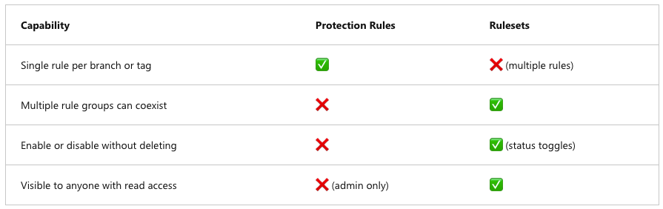
Comparing Rulesets, branch protection, and protected tags
Key advantages of rulesets
Layering: Aggregate rules from multiple sources; the strictest setting applies.
Statuses: Enable, disable, or evaluate (test) rulesets without deletion.
Transparency: Developers and auditors can view active rulesets with read access, without admin rights.
Notes:
Traditional branch protection rules let you apply a single set of controls—like required reviews or status checks—directly to one branch or tag. But they’re limited: you can’t layer multiple independent rule sets on the same target, you must delete and recreate rules to change them, and only administrators can even see those settings.
Repository rulesets solve these drawbacks by allowing you to bundle multiple rules together under a named profile, apply them to any combination of branches or tags, and toggle them on or off without deletion. You can have several rulesets coexisting—each governing different aspects of the same branch—and you can even import existing tag protections into a ruleset for reuse. Crucially, rulesets are visible to anyone with read access, so developers and auditors alike have full transparency into the active security policies.
The key advantages of rulesets are:
Layering: They aggregate rules from multiple sources—branch protections, tag protections, or direct ruleset definitions—with the strictest setting winning out.
Statuses: You can enable, disable, or put a ruleset into “evaluate” mode for testing, without disrupting the underlying configuration.
Transparency: Since rulesets are readable by anyone with repo access, there’s no hidden admin‑only policy: every contributor can see which safeguards are in place.
By adopting rulesets, you gain a scalable, flexible, and auditable framework for securing your branches and tags—without the administrative friction of one‑off, manually managed protections.

Slide 21
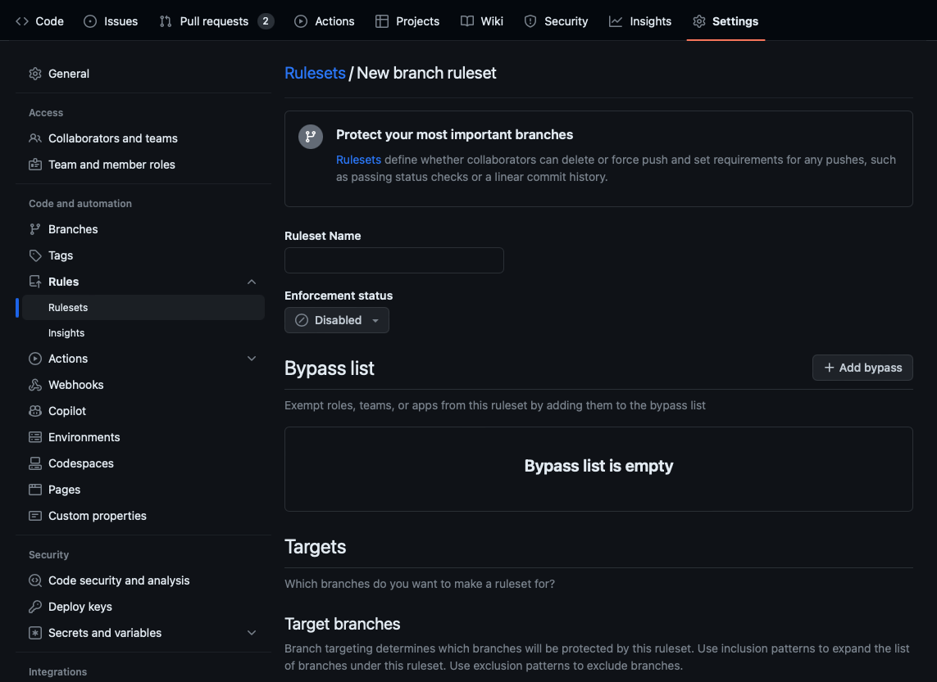

Creating your first Ruleset
On GitHub.com, navigate to Settings > Code and automation > Rules > Rulesets.
Click New ruleset, then select Branch or Tag.
Enter a name and choose your target branches or tags.
Toggle rules such as Require status checks or Block force pushes.
Assign bypass permissions (e.g., Admins, CI App).
Click Create.
For release branches (release/*), require two successful status checks and block force pushes to enforce stability.
Notes:
Let’s set up your first repository ruleset, which will let you enforce multiple protections in one place.
Start by navigating to Settings → Code and automation → Rulesets, and choose whether you’re targeting branches or tags. Give your ruleset a descriptive name—like “Feature-Branch Security”—and then specify the branch or tag patterns it applies to (for example, feature/* or v1.*).
Next, toggle on the protections you need: require passing status checks to ensure builds and tests succeed before merge, enforce signed commits to guarantee authorship integrity, and block force pushes to protect your commit history. You can also assign bypass permissions so that trusted roles—such as repository admins or your CI application—can override specific rules when necessary.
Once you click Create, your ruleset is active. For release branches (release/*), a good practice is to require at least two successful status checks and block force pushes—this combination keeps your releases stable while still allowing you to patch critical fixes under controlled conditions. With rulesets in place, you have a flexible, transparent framework for securing your most important branches and tags.

Slide 22
Managing and editing Rulesets
View active rulesets: On the Rulesets page, see which sets target a given branch or tag.
Edit a ruleset: Click its name, adjust rules or targets, then Save changes.
Toggle status: Enable or disable a ruleset without deleting it.
Delete: Remove obsolete rulesets when they’re no longer needed.
Notes:
Once your rulesets are in place, ongoing management keeps them aligned with your evolving workflows. On the Rulesets page, you’ll see every active ruleset and the specific branches or tags it targets—making it easy to verify coverage at a glance.
To update a ruleset, simply click its name, tweak the target patterns or protection rules as needed, and hit Save changes—no deletion required. If a ruleset needs to be paused—for example, to troubleshoot a failing status check—you can toggle it off and then on again later. And when a ruleset becomes obsolete—perhaps a long‑lived release branch is retired—you can remove it entirely with the Delete option.
By leveraging these editing and toggling capabilities, you maintain a flexible, transparent security posture without losing any of the protections you’ve carefully configured.

Slide 23
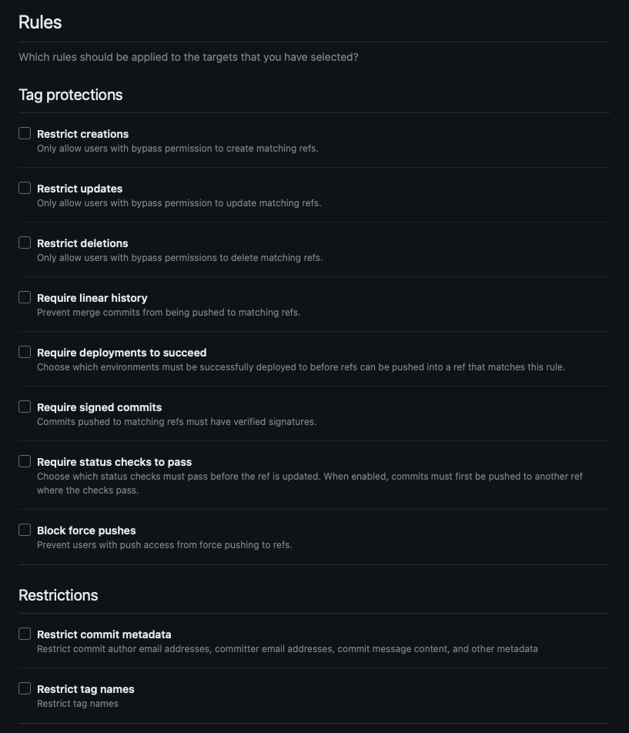
Available rules
Repository rulesets support many of the same protections as branch and tag protection:
Common examples:
Require status checks to pass (e.g., CodeQL, Dependency Review).
Require signed commits.
Block force pushes or deletions.
Restrict who can push or merge.
Enforce your CI/CD pipeline by requiring key workflows as status checks before merges.
Notes:
Repository rulesets expose the same core protections you’re familiar with from branch and tag settings, but in a unified, reusable format. You can toggle rules such as:
Require status checks to pass, ensuring key workflows—like CodeQL scans or Dependency Review—complete successfully before a merge is allowed.
Require signed commits, which guarantees that every commit is attributed to a verified author.
Block force pushes or deletions, protecting your commit history and tags from accidental or malicious rewrites.
Restrict who can push or merge, so only designated users, teams, or GitHub Apps can make changes to sensitive branches.
Tip: Enforce your CI/CD pipeline by adding your critical build and test workflows as required status checks—this way, no PR can merge until your automated validations greenlight it.

Slide 24
Layering Rulesets and protections
GitHub aggregates all applicable rules—branch protection, tag protection, and multiple rulesets—and applies the most restrictive setting.
Example: The my-feature branch has:
A ruleset requiring signed commits and three reviews.
A branch protection rule requiring a linear history and two reviews.
Outcome: Pull requests need three reviews, and commits must be both signed and linear.
Notes:
One of the strengths of GitHub’s security model is its ability to layer protections from different sources—branch protection rules, tag protection rules, and multiple repository rulesets—and then enforce the most restrictive combination.
For example, imagine you have a branch called my-feature with two sets of controls:
A ruleset that requires every commit to be signed and mandates three approving reviews
A classic branch protection rule that demands a linear history and two reviews
When both apply, GitHub aggregates them and enforces the strictest requirements: your pull requests must now receive three reviews (not two), and every commit must satisfy both the signed‑commit and linear‑history checks.
This layered approach ensures that as you introduce new protections or import existing ones into rulesets, you never weaken your guardrails—GitHub always honors the highest standard from all active rules.

Slide 25
Impacts of policy and Ruleset choices in GitHub Enterprise
Your policies and rulesets affect security, compliance, developer experience, and operational efficiency. Finding the right balance between control and flexibility is essential.
Security & Compliance Enforcement
Positive Impact: | Potential Drawbacks
Enforcing SAML SSO & 2FA enhances authentication security and prevents unauthorized access. Branch protection rules prevent accidental code changes and ensure that every modification is reviewed. Audit logging & security rulesets help meet compliance standards (SOC 2, ISO 27001) by tracking all activities. | Overly strict security policies (e.g., blocking all forks, forcing lengthy approval chains) can frustrate developers and slow down workflows. Manual security enforcement (vs. automated rulesets) increases admin overhead.
Notes:
When you define security policies and rulesets at the enterprise level, you’re shaping not just your compliance posture but also your developers’ day‑to‑day experience and your own operational workload. Let’s look at a few real‑world trade‑offs:
Enforcing SAML SSO & 2FA via rulesets
Pro: You block unauthorized access at the door, ensuring every user is verified through your corporate identity provider and second‑factor check.
Con: If you go too far—say, by preventing forks or requiring multi‑step approvals for every change—you risk frustrating developers and slowing innovation.
Branch protection requirements
Pro: Mandatory reviews and status checks guarantee that each code change undergoes peer review and passes CI pipelines before merging, boosting code quality and security.
Con: Heavy manual checks add administrative overhead—assigning reviewers, triaging approvals, and managing exception workflows can consume significant resources.
Audit‑logging rulesets for SOC 2/ISO 27001 compliance
Pro: Centralized logs and immutable audit trails demonstrate to auditors that you’re enforcing consistent, organization‑wide policies—critical for passing formal security assessments.
Con: (Often) configuring and maintaining comprehensive logs and retention policies can introduce complexity into your GitHub Enterprise setup.
By weighing these pros and cons, you can find the sweet spot between rigid enforcement and developer agility—scaling up controls where the risk is highest, while preserving flexibility in less critical areas.

Slide 26
Impacts of policy and Ruleset choices in GitHub Enterprise (continued)
Developer productivity and workflow efficiency
Positive Impact: | Potential Drawbacks
Automated security tools (e.g., Dependabot, Code Scanning, Secret Scanning) reduce the burden on developers while maintaining security. Using security rulesets for automated compliance checks helps enforce policies without manual intervention. Flexible branch protections (e.g., requiring reviews only for critical branches) maintain agility without sacrificing security. | Strict approval policies (e.g., requiring multiple PR reviews, no direct commits) can slow down fast-moving teams. Blocking force pushes prevents rewriting history but can create challenges for hotfixes in certain workflows.
Notes:
When designing your security posture, keep an eye on how policies impact developer productivity and workflow efficiency.
Pros:
Automated checks like Dependabot and Code Scanning take routine security tasks off your team’s plate, surfacing issues through pull requests without manual intervention.
Security rulesets let you enforce compliance automatically—once configured, they run in the background and relieve developers from remembering dozens of individual settings.
Flexible protections (for example, applying reviews only on critical branches) give teams the agility to move fast on feature work, while still locking down high‑risk code paths.
Cons:
Strict approval policies—such as requiring multiple reviews on every branch—can bottleneck teams that prize speed, especially if reviewers are overloaded.
Blocking force pushes is important for history integrity, but in true emergencies it can complicate the process of issuing urgent hotfixes.
The key is to tailor automation and rulesets so that you eliminate repetitive manual chores without introducing unnecessary roadblocks—striking the right balance keeps both security and productivity humming.

Slide 27
Impacts of policy and Ruleset choices in GitHub Enterprise (continued)
Governance and access control
Positive Impact: | Potential Drawbacks
Enforcing repository visibility rules prevents accidental exposure of private code. Fine-grained access controls ensure the right people have appropriate permissions. Restricting actions and forking reduces the risk of intellectual property leaks. | Over-restricting repository access can lead to bottlenecks, where teams struggle to collaborate effectively. Blocking forking and pull requests in open-source projects hinders external contributions.
Notes:
In addition to security policies, governance and access controls shape how teams interact with your codebase and safeguard your intellectual property.
Visibility rules ensure that private repositories and sensitive branches remain hidden from unauthorized eyes, preventing accidental leaks of proprietary code. However, if you over‑restrict visibility—locking down too much—you can inadvertently create silos and slow cross‑team collaboration.
Fine‑grained permissions let you assign exactly the right level of access to each user or team—read, triage, write, maintain, or admin—so contributors see only what they need. The trade‑off comes when open‑source workflows require broad forking and community contributions; blocking forks too aggressively can stifle external participation and innovation.
Fork restrictions are a powerful way to protect your organization’s intellectual property by preventing clones of private repos. This reduces the risk of proprietary code being copied into uncontrolled environments, but it must be applied judiciously—especially in public or open‑source projects where forking is the lifeblood of community engagement.
Finding the right balance in governance means protecting your assets while still empowering both internal and external contributors to collaborate effectively

Slide 28
Impacts of policy and Ruleset choices in GitHub Enterprise (continued)
CI/CD and automation impact
Positive Impact: | Potential Drawbacks
Policies like requiring status checks before merging ensure that every change is tested before deployment. Using GitHub Actions with security rulesets enables automated enforcement of compliance requirements. Code Scanning & Dependency Management integrate security best practices directly into development workflows. | Strict CI/CD security rules (e.g., requiring all workflows to be manually approved) can slow down automated deployments. Blocking third-party GitHub Actions might enhance security but limits automation options for developers.
Notes:
When we integrate CI/CD and automation into our security posture, we see clear benefits—and some trade‑offs:
Requiring status checks ensures code is validated before deployment, catching build failures or test regressions early in the pipeline. The flip side is that strict CI approvals can slow down deployments if teams have to wait for every check to finish before merging.
Integrating GitHub Actions with rulesets automates compliance, so every workflow run automatically honors your security policies—no manual gating required. However, blocking third‑party Actions limits automation options, forcing you to rely only on approved workflows and potentially missing out on useful community tools.
Finally, built‑in code scanning and dependency management embed security directly into your pipelines, surfacing vulnerabilities as part of your normal build process. While this adds a bit of maintenance overhead to keep your scanning rules and dependency alerts up to date, it pays dividends by catching issues before they reach production.

Slide 29
GitHub audit log APIs for investigating missing assets
Audit logs provide visibility into events such as repository deletions or member removals. Use REST or GraphQL to query and remediate.
Steps to troubleshoot missing assets:
Steps 1 - 3
Steps 4 & 5
Identify the asset:
Review event metadata:
Determine what is missing (e.g., repository, user, or team).
Determine what is missing (e.g., repository, user, or team).
Query the audit log API:
Take corrective actions:
Use REST or GraphQL to retrieve logs related to asset deletions or modifications.
Restore assets if applicable or take security measures.
Filter results by event type:
Focus on repository.deleted, org.member_removed, or similar events.
Notes:
When a critical asset—like a repository or team membership—goes missing, the GitHub audit log is your forensic trail. You can query it via REST or GraphQL to pinpoint exactly who performed the action and when.
Identify the asset and event you’re concerned about, such as repository.deleted or org.member_removed.
Query via the REST API Or use the GraphQL API for more flexible queries.
Filter and inspect the returned entries to find the precise event, who triggered it, and any related context.
Remediate based on your findings: restore the deleted repository, re‑invite the removed member, or tighten permissions and branch protections to prevent future incidents.

Slide 30
Audit Log APIs (REST and GraphQL) to Investigate Missing Assets
Example REST API Request:
Example GraphQL Query:
GET /orgs/{org}/audit-log?
phrase=repository.deleted
Authorization: Bearer YOUR-TOKEN
query {
auditLogEntries(first: 10, query: "repository.deleted") {
nodes {
action
actor {
login
}
createdAt
}
}
}
Notes:
Here are two examples to query GitHub’s audit logs using REST and GraphQL.
REST API Example
Replace {org} with your organization’s name and use a personal access token or GitHub App token with admin:org scope.
The phrase parameter filters entries to only those whose action matches repository.deleted.
The response returns a list of audit‐log entries with full context—timestamps, actors, and any additional metadata.
The phrase parameter filters entries to only those whose action matches repository.deleted.
The response returns a list of audit‐log entries with full context—timestamps, actors, and any additional metadata.
GraphQL API Example
With GraphQL, you can tailor the response to return exactly the fields you need—here, the action name, the user who performed it (actor.login), and the timestamp (createdAt).
The first: 10 argument limits results to the ten most recent matching events.
This approach is ideal when you want to embed audit-log queries in dashboards or custom tools.
By mastering both REST and GraphQL audit‐log queries, you can quickly investigate incidents, automate alerts, and maintain a clear audit trail for compliance and troubleshooting.

Slide 31
Reporting and logging
When an unexpected event occurs—like a repository deletion or a failed workflow run—you need precise details: who did it, when, and how. GitHub’s audit logs capture this information for troubleshooting, compliance, and security investigations.
You can access the audit log through GitHub.com, GitHub Enterprise Server, or GitHub AE. Interacting with the audit log via either the GraphQL API or the REST API allows you to retrieve specific types of information, though there are some limitations.
Suppose a critical repository vanished overnight. You’ll use the audit logs to pinpoint the deletion event and restore continuity.
Notes:
When something unexpected happens—say a repository suddenly disappears or a critical workflow fails—you need answers fast: who triggered the event, exactly when it occurred, and through which channel. That’s where GitHub’s audit logs come in.
You can view these logs directly in GitHub.com’s admin UI, or access them programmatically via the REST or GraphQL APIs, whether you’re on GitHub Enterprise Server or GitHub AE. Each entry records the action name, the actor’s identity, a timestamp, and relevant metadata—giving you a clear forensic trail for troubleshooting or compliance audits.
Tip: Imagine you wake up to find a key repo has been deleted overnight. By querying your audit log for repository.deleted events, you can identify the user responsible, the exact time of deletion, and quickly restore the repo—minimizing downtime and preserving trust in your processes.

Slide 32
What are Log Records?
Your organization’s audit log records actions taken by organization members. Available to organization owners, the log provides information about actions that affect the organization, including:
The repository in which the action was performed.
The user who performed the action.
The action that was performed.
The country or region where the action took place.
The action’s date and time.
Note: Logs are retained for up to 90 days in GitHub Enterprise Cloud (120 days via GraphQL on Enterprise Server).
Notes:
Log records form the backbone of GitHub’s audit logging system, capturing every significant action taken by organization members. Available to organization owners, these records tell you:
Which repository the action occurred in,
Who performed the action,
What action was executed (for example, repository.deleted or team.member_removed),
Where the request originated—the user’s country or region, and
When it happened, with precise date and time stamps.
This comprehensive metadata gives you full visibility into organizational changes, helping with troubleshooting, security investigations, and compliance audits.
Note: Audit log entries are retained for up to 90 days on GitHub Enterprise Cloud (and up to 120 days via GraphQL on Enterprise Server), so make sure to export or archive any critical records before they expire.

Slide 33
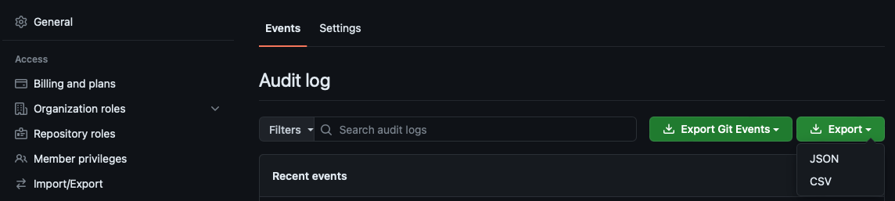
Viewing and exporting Audit Logs via the GitHub UI
For compliance and record-keeping purposes, you should export your audit logs in a common format. Follow these steps to access and export your audit logs:
If you want to export an audit log that focuses on specific events, like those enacted by one user or that happened on a given day, you can filter the audit log results by adding a qualifier and accompanying value to the Filters field next to the Export drop-down menu.
On GitHub.com, navigate to your organization’s Settings > Audit log.
Use the Filters field to narrow results by qualifier (actor, repo, action, date).
Click Export and choose CSV or JSON to download.
Qualifier | Example value
action | team.create
actor | octocat
user | codertocat
org | octo-org
repo | octo-org/documentation
created | 2019-06-01
Notes:
To investigate or demonstrate audit‑log activity, navigate to Settings → Audit log in your organization on GitHub.com. Here, you’ll see a chronological feed of every significant event—repo deletions, team creations, permission changes, and more.
Use the Filters field to narrow your view by qualifiers such as:
action (e.g., team.create)
actor (e.g., octocat)
user (e.g., codertocat)
org (e.g., octo-org)
repo (e.g., octo-org/documentation)
created date (e.g., 2019-06-01)
Once you’ve refined your search, click Export and choose CSV or JSON to download a snapshot of those log entries. This export provides a portable, filterable record you can share with auditors, load into analysis tools, or archive for long‑term compliance.

Slide 34
Accessing Audit Logs via API
REST API
GraphQL API
Scope: Enterprise Cloud (up to 90 days; Git events for 7 days).
Monitors: Settings changes, permission updates, team membership, application changes, plus Git events (push, pull, merge).
Scope: Enterprise Server (up to 120 days).
Monitors: Settings changes, permission updates, team membership, application changes.
Limitations: Does not include Git events (pushes, pulls).
GET /orgs/{org}/audit-log?phrase=git.push
Authorization: Bearer YOUR_TOKEN
query {
auditLogEntries(first: 20, query: "org:octo-org action:repo.cleanup") {
nodes {
action
actor { login }
createdAt
repository { name }
}
}
}
Notes:
To automate auditing or integrate GitHub events into your own dashboards, you can query the audit log programmatically via REST or GraphQL APIs.
REST API (Enterprise Cloud)
Scope: Retrieves events from the past 90 days (with Git events like push, pull, and merge included for up to 7 days).
Use cases: Track settings changes, permission updates, team‐member modifications, and CI/CD push events.
Example call:
Replace {org} with your organization name and supply a token with the admin:org scope. You can adjust the phrase filter to any action qualifier to zero in on the exact event you need.
GraphQL API (Enterprise Server)
Scope: Captures up to 120 days of non‑Git events—settings changes, permission tweaks, and membership updates—but does not include Git push/pull actions.
Use cases: Ideal for deep historical analysis of administrative changes or compliance reporting.
Example query:
This GraphQL query filters to repo.cleanup actions within octo-org, returning the actor, timestamp, and target repository name.
By choosing the appropriate API and filters, you can programmatically monitor audit events, alert on suspicious activity, and maintain a searchable, long‑term audit trail outside of GitHub’s UI.

Slide 35
Investigating missing assets
HTTP
GET /orgs/{org}/audit-log?phrase=repository.deleted
Authorization: Bearer YOUR_TOKEN
To recover or audit missing resources like repositories or teams:
Identify the asset (e.g., repository.deleted).
Query the API with event filters:
REST: ?phrase=repository.deleted
GraphQL: query auditLogEntries(query: "repository.deleted")
Inspect metadata: actor, timestamp, repository/team name.
Remediate: restore from backup or revisit permissions.
GraphQL
query {
auditLogEntries(first: 10, query: "repository.deleted") {
nodes {
action
actor { login }
createdAt
}
}
}
Notes:
When a critical resource—like a repository or team—goes missing, your first step is to identify the asset and the corresponding audit event (for example, repository.deleted).
Next, query the audit log via the REST or GraphQL API using a phrase or query filter for that action:
These calls return entries showing who performed the deletion, when, and what was affected.
Finally, use that metadata—actor, timestamp, and resource name—to remediate the issue. This might mean restoring the repository from a backup, re‑inviting team members, or adjusting permissions to prevent future accidental deletions. By following these steps, you can quickly recover missing assets and tighten your governance controls.

Slide 36
Use cases for Audit Logs
 | Security incidents: Trace unauthorized access or data exfiltration.
 | Compliance audits: Demonstrate policy enforcement (SOC 2, ISO 27001).
 | Operational troubleshooting: Diagnose CI/CD failures or permission errors.
 | Access monitoring: Review API token usage and SSH/Git activity.
Notes:
GitHub’s audit logs serve multiple critical purposes across security, compliance, and operations:
Security incidents: When you suspect unauthorized access or data exfiltration, audit logs let you trace exactly which user or token performed specific actions—helping you reconstruct an attacker’s path and contain the breach.
Compliance audits: External auditors often require proof that you enforce policies consistently. By exporting audit logs for SOC 2 or ISO 27001 reviews, you can demonstrate that controls—like branch protection changes or permission updates—were applied according to your stated procedures.
Operational troubleshooting: CI/CD pipelines sometimes fail or behave unexpectedly due to permission misconfigurations or workflow changes. Reviewing audit entries for events like workflow.run or permission.update helps you pinpoint the root cause without guesswork.
Access monitoring: To ensure tokens and SSH keys aren’t being abused, you can filter logs for git.push or oauth.token_created events—allowing you to spot unusual patterns in API or Git activity and revoke compromised credentials before they cause harm.

Slide 37
Audit Logs
Security and Compliance in GitHub Audit Logs:
Audit Log Streaming
Additional Audit Log types
Stream logs in real time to SIEM platforms (Splunk, Datadog) for long-term storage:
Git Activity Log: Tracks pushes, pulls, merges (phrase=git.push).
API Activity Log: Tracks REST/GraphQL requests (phrase=api.request).
Enterprise Managed Users (EMU): Includes user.login, repository.permissions_updated, repository.forked.
Token Usage: Filter by phrase=token to identify compromised credentials.
Data Retention: GitHub retains audit logs for up to 90 days for GitHub Enterprise Cloud.
Access Control: Only organization owners and security managers can view audit logs.
IP Logging: Includes source IP addresses to track actions.
GDPR & Compliance: Ensures that actions within GitHub align with compliance standards.
Go to Settings > Audit log.
Under Streaming, configure a destination (AWS S3, Azure Event Hubs).
Verify events arrive in your SIEM.
Notes:
GitHub’s audit logs are not just a record of activity—they’re a critical component of your security and compliance strategy. On Enterprise Cloud, logs are retained for 90 days, while Enterprise Server holds them for 120 days, giving you a clear window for investigation. Access to these logs is tightly controlled: only owners and security managers can view them, which enforces the principle of least privilege.
Every log entry includes the source IP address, helping you detect unusual login patterns or geolocation anomalies. And because GitHub meets major regional data‑handling requirements, you can rely on these logs to satisfy GDPR, HIPAA, or other compliance mandates without managing separate audit systems.
For longer‑term retention and centralized analysis, you can stream audit logs in real time to your SIEM platform—whether that’s Splunk, Datadog, or another. Simply go to Settings → Audit log, scroll to the Streaming section, and configure your destination—like AWS S3 or Azure Event Hubs. Once set up, verify that events are arriving downstream, giving you both immediate alerts and an audit‑ready archive beyond GitHub’s native retention window.
Beyond standard org and repo events, GitHub provides specialized audit streams:
Git Activity Log: Tracks code operations—pushes, pulls, merges—using filters like phrase=git.push.
API Activity Log: Monitors all REST and GraphQL calls (phrase=api.request), so you can spot abnormal API usage.
Enterprise Managed Users (EMU): Captures events specific to EMU accounts, such as user.login, repository.permissions_updated, and repository.forked.
Token Usage: By filtering on phrase=token, you can identify when tokens are created or used—key for detecting compromised credentials.

Slide 38
Key security features of a GitHub Repository
SECURITY.md: | Define reporting process and supported versions.
Branch Protection: | Enforce reviews, status checks, and commit signing.
Dependabot Alerts: | Automatic vulnerability detection and updates.
Code Scanning: | Continuous analysis via CodeQL.
Secret Scanning & Push Protection: | Real-time prevention and alerts.
Security Advisories: | Draft, collaborate, and publish advisories.
Dependency Graph: | Visualize and audit dependencies.
2FA & RBAC: | Enforce strong authentication and least privilege.
Notes:
GitHub provides a comprehensive suite of built-in security controls to harden your repositories. Let’s walk through the essentials:
SECURITY.md
Use this file to define exactly how—and to whom—contributors should report vulnerabilities, and to list the versions of your project you actively support. It sets clear expectations and channels for responsible disclosure.
Branch Protection
Enforce pull‑request reviews, require passing status checks (like your CI builds or linters), and mandate commit signing to ensure that every change is vetted, tested, and attributable before it reaches your protected branches.
Dependabot Alerts
Automatically notify your team when a dependency has a known vulnerability, and even open pull requests to update to safer versions—keeping your supply chain secure with minimal manual effort.
Code Scanning
Powered by CodeQL, this feature continuously analyzes your code for security flaws and common errors, surfacing results directly in your pull‑request workflow so you can triage and fix issues early.
Secret Scanning & Push Protection
Detect API keys, tokens, and other credentials in real time as they’re committed. Push protection can block these commits entirely, preventing secrets from ever landing in your history.
Security Advisories
Collaborate privately on fixes, draft detailed advisories, and then publish to notify users and the broader community—integrating with the CVE ecosystem for standardized vulnerability tracking.
Dependency Graph
Visualize every direct and transitive library your project depends on, so you can audit your entire dependency tree at a glance and understand your risk surface.
Two‑Factor Authentication (2FA) & Role‑Based Access Control (RBAC)
Require 2FA for all contributors to prevent account takeover, and apply the principle of least privilege with fine‑grained repository roles—ensuring users have only the permissions they need.
By enabling and configuring these features, you build a layered defense that guards your code, dependencies, and secrets—while still empowering your team to deliver software quickly and confidently.

Slide 39
API access and integrations
Personal Access Tokens (PAT)
Personal Access Tokens (PAT) are used to authenticate to GitHub on behalf of a user. They provide access to the user's resources and can be used for personal automation tasks. PATs are tied to a specific user account and can be scoped to limit access to certain resources.
Installation Tokens
Installation Tokens are used by GitHub Apps to authenticate on behalf of an installation. These tokens are short-lived and provide access to the repositories and resources that the GitHub App has been granted permission to access.
OAuth Tokens
OAuth Tokens are used by OAuth Apps to authenticate and authorize access to a user's resources. These tokens are obtained through the OAuth 2.0 authorization flow and provide access based on the permissions granted by the user.
GitHub App OAuth Tokens
GitHub App OAuth Tokens are similar to OAuth Tokens but are specifically used by GitHub Apps. These tokens allow GitHub Apps to authenticate and perform actions on behalf of a user, with the permissions granted during the OAuth authorization process.
Device Tokens
Device Tokens are used for device-based authentication. They are typically used in scenarios where a user needs to authenticate on a device that does not have a web browser, such as a command-line tool or a mobile app.
Refresh Tokens
Refresh Tokens are used to obtain new access tokens without requiring the user to re-authenticate. They are typically used in conjunction with OAuth Tokens to maintain long-lived sessions and reduce the need for repeated logins.
Notes:
Let’s start with the basics: authentication tokens. GitHub provides different types of tokens based on who—or what—is doing the accessing.
Personal Access Tokens (PATs) are tied to an individual user. These are like your all-purpose keys—great for personal scripts and testing, but not ideal for shared systems or long-term use.
Installation Tokens are used by GitHub Apps. They’re short-lived and scoped to just what the app needs. It’s a safer and cleaner way for apps to operate independently of user accounts.
OAuth Tokens come from apps that use the OAuth 2.0 flow. These are based on permissions granted by a user during an authorization step—good for integrations that users manually connect to.
GitHub App OAuth Tokens are like OAuth tokens, but specific to GitHub Apps. They’re scoped and secure, with fine-grained permissions.
Device Tokens help when users log in from devices that don’t have browsers—think command-line tools or IoT devices.
Refresh Tokens are used with OAuth to get new access tokens without having the user log in again.
So why so many options? Because security and control matter. GitHub lets you choose what’s best for your workflow and risk profile.

Slide 40
Token Rate Limits Using the API Insights Dashboard
GitHub enforces rate limits on API requests to ensure fair usage and prevent abuse. The rate limits depend on the type of authentication used:
Unauthenticated requests: 60 requests per hour
Authenticated requests (using a personal access token or OAuth token): 5,000 requests per hour per user
GitHub Apps (installation tokens): Varies based on installation scope
Checking Rate Limits Using GitHub API
You can also check your API rate limits programmatically using the following REST API request:
Example Response:
limit: Maximum allowed requests
remaining: Requests left in the current window
reset: Timestamp when the rate limit resets
curl -H "Authorization: token YOUR_GITHUB_TOKEN" \
-H "Accept: application/vnd.github.v3+json" \
https://api.github.com/rate_limit
{
"rate": {
"limit": 5000,
"remaining": 4990,
"reset": 1633024800
}
}
Monitoring Rate Limits Using the API Insights Dashboard
GitHub provides an API Insights Dashboard that allows users to track and analyze API usage, including rate limits.
Steps to Access the API Insights Dashboard:
Navigate to GitHub API Insights (for personal access tokens) or the GitHub Apps settings for installed applications.
Select the API Insights section.
Review rate limits, request trends, and usage statistics.
Notes:
GitHub enforces API rate limits so that no one user or app can overload the system—and that includes you, even if you’re doing something totally valid!
If you're unauthenticated, you get 60 requests per hour.
With a personal access token or OAuth token, you get 5,000 per hour.
With GitHub Apps, the limits depend on the app’s installation and what it’s accessing.
To track all this, GitHub provides an API Insights Dashboard. It gives you a visual breakdown of how many requests you’re making, which endpoints you’re using, and when you might hit a wall.
You can also use the GitHub API directly to check your current usage in the following REST API request:
This shows you your remaining quota and when it resets.
To stay below the limit:
Authenticate your requests.
Be smart—don’t ask for more than you need.
Use pagination and webhooks instead of polling every 5 seconds.

Slide 41

Exercise
This exercise checks your knowledge about removing a commit from the git history of a repository.
This GitHub exercise is graded automatically after you attempt a solution to the challenge. The results of your actions, and helpful feedback, are provided in real-time within the grade-learner workflow logs.
Here are some helpful tips before you begin the exercise:
Read the About this exercise section in the exercise's repository README to understand how the exercise works.
Follow the steps provided in the Instructions section to successfully complete the exercise.
To see the results of your exercise, navigate to the Actions tab of your cloned repository and select the most recent run on the Grading workflow.
Stuck on what to do? Revisit the content in the last unit or check out the Useful resources section in the exercise's repository README for more resources.
Notes:
Now it’s time to apply what you’ve learned about removing sensitive data from your Git history. In this exercise, you’ll work in a template repository that intentionally contains a commit with unwanted content. Your goal is to rewrite the history to remove that commit entirely.
Read the README in the exercise repo to understand the scenario and how the grading workflow validates your solution.
Follow the Instructions section step by step—using tools like git filter-branch, git filter-repo, or the BFG Repo‑Cleaner—to excise the target commit and clean up your reflog and garbage collection.
Verify in Actions: After pushing your cleaned history, check the “Grading” workflow under the Actions tab for real‑time feedback and scoring.

Slide 42
Exercise - (continued)
Note: A grading script exists under .github/workflows/grading.yml. You don't need to modify this workflow to complete this exercise. Altering the contents in this workflow can break the exercise's ability to validate your actions, provide feedback, or grade the results.
This exercise is a challenge based on content covered in this module. It might take several attempts to complete the exercise, you can revisit previous content in this module, or navigate to some of the other resources provided as many times as you want to find the solution.
After you finish the exercise in GitHub, return here for:
A quick knowledge check
A summary of what you've learned
A badge for completing this module
Start the exercise on GitHub.
Notes:
If you get stuck, revisit our previous unit on sensitive‑data removal or use the “Useful resources” links in the exercise’s README. Remember: do not modify the .github/workflows/grading.yml file, as it’s the script that validates your work.
When you’ve successfully scrubbed the commit and seen a passing grade, return here for a quick knowledge check, a summary of your takeaways, and—of course—your well‑earned badge!
Click Start the exercise on GitHub when you’re ready!

Slide 43
Knowledge Checks
Notes:
You’ve just completed the hands‑on exercise for scrubbing commits from your history—great job!
Now, let’s reinforce those learnings with a quick four‑question knowledge check.
These questions will cover key concepts like history rewriting tools, proper cleanup steps, and best practices for rotating exposed credentials.
Read each question carefully, select the best answer, and use this as an opportunity to solidify your understanding before we wrap up.

Slide 44
Knowledge Check: Manage sensitive data and security policies within GitHub
1 of 4
What file should you use to create documentation for collaborators that lists supported versions of the project?
SECURITY.md
CONTRIBUTING.md
SUPPORT.md
© Copyright Microsoft Corporation. All rights reserved.
Notes:
1. What file should you use to create documentation for collaborators that lists supported versions of the project?
a. SECURITY.md
Explains how to report vulnerabilities and typically lists the versions your project actively supports.
b. CONTRIBUTING.md
Describes contribution guidelines (coding standards, pull‑request process), but doesn’t cover supported versions.
c. SUPPORT.md
Points users to help resources (forums, issue trackers), but not version support details.
Correct answer: a

Slide 45
Knowledge Check: Manage sensitive data and security policies within GitHub
2 of 4
What tool should you use to automate part of your security process?
Add Dependabot to your code base.
Add access restrictions to your enterprise.
Create security documentation.
Add advisories for your users.
© Copyright Microsoft Corporation. All rights reserved.
Notes:
What tool should you use to automate part of your security process?
a. Add Dependabot to your code base.
Dependabot automatically scans dependencies for vulnerabilities and opens pull requests to update them.
b. Add access restrictions to your enterprise.
A manual configuration for governance, not an automation tool.
c. Create security documentation.
Important for guidance, but not an automated process.
d. Add advisories for your users.
Security Advisories manage disclosures but don’t automate detection or updates.
Correct answer: a

Slide 46
Knowledge Check: Manage sensitive data and security policies within GitHub
3 of 4
Which two pieces of information should be included in a security advisory?
Product affected and severity.
Severity and exposure list.
Administrator name and severity.
Exposures list and administrator name.
© Copyright Microsoft Corporation. All rights reserved.
Notes:
Which two pieces of information should be included in a security advisory?
a. Product affected and severity.
Clearly identifies which versions or components are vulnerable and how critical the issue is.
b. Severity and exposure list.
“Exposure list” is vague—advisories need affected versions, not an abstract “exposure list.”
c. Administrator name and severity.
The admin’s identity isn’t relevant to users; severity is.
d. Exposures list and administrator name.
Neither element matches the standard advisory fields.
Correct answer: a

Slide 47
Knowledge Check: Manage sensitive data and security policies within GitHub
4 of 4
Which two pieces of information are included in your organization's log?
The user that performed the action and the date and time of the action.
The date and time of the action and changes in permissions.
Changes in permissions and users being promoted to administrators.
Users being promoted to administrators and the user that performed the action.
© Copyright Microsoft Corporation. All rights reserved.
Notes:
Which two pieces of information are included in your organization’s log?
a. The user that performed the action and the date and time of the action.
Audit logs record exactly who did what and when.
b. The date and time of the action and changes in permissions.
The log does include timestamps and permission‑change events, but it always records the actor too.
c. Changes in permissions and users being promoted to administrators.
These are specific actions, but the log also universally records who and when.
d. Users being promoted to administrators and the user that performed the action.
“User that performed the action” is redundant here, and promotions are just one type of event.
Correct answer: a

Slide 48
Summary
In this module, you learned how to protect your GitHub organization from security risks and what to do if there's a sensitive data exposure.
You learned how to:
Create documentation to outline security guidelines and provide useful information for collaborators.
Set permissions and rules.
Manage repository rulesets.
Automate processes that prevent security risks.
Respond to sensitive data exposure.
Export audit log records and git events.
Learn more
Here are some links to more information on the topics we discussed in this module.
Adding a security policy to your repository.
Creating a default community health file
About repository security advisories
Creating a security advisory
GitHub security features
Quickstart for securing your repository
Quickstart for securing your organization
Managing rulesets for a repository
Ignoring files
Best practices for preventing data leaks in your organization
Reviewing the audit log for your organization
Audit log events for your organization
Reference for working with an audit log using the GraphQL API
Reference for working with an audit log using a Rest API
git-filter-repo Manual Page
Notes:
In this module, you gained a holistic security toolkit for GitHub: from drafting clear reporting guidelines in SECURITY.md, to locking down branches with rulesets, to automating dependency updates and code scans. You practiced removing credentials from history and used audit logs to trace and remediate incidents. Armed with these practices—plus the ability to stream logs for long‑term retention—you can protect your organization’s code and data at every step of the development lifecycle.
You defined and documented security policies (e.g., SECURITY.md) to guide collaborators.
You configured fine‑grained permissions and repository rulesets to enforce branch and tag protections.
You automated vulnerability management with Dependabot, code scanning, and secret scanning.
You learned how to scrub sensitive data from Git history and respond to exposed secrets.
You accessed and exported audit logs—via UI and APIs—to investigate incidents and demonstrate compliance.

Slide 49
Resource Links
Removing sensitive data from a repository
BFG Repo-Cleaner
git filter-repo
git filter-repo INSTALL.md
Cloning a repository
About Releases
GitHub Community Guidelines

